Slide 1
The Earth’s Core

Slide 2
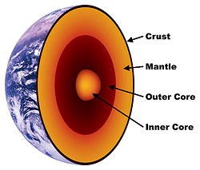

Slide 3
Crust
Also called the lithosphere, about 6-40km thick depending on the area
Crust is 3 times as thick under continents than the ocean
Consists mostly of sand and rock

Slide 4
Mantle
Parts of this layer become hot enough to become slow moving molten rock or magma
Represents about 85% of the earth’s weight

Slide 5
Inner Core
A mass of sold iron and with a temperature of 7000 degrees!
Approx. 5000km below the earth, 2500km in diameter

Slide 6
Outer Core
Outer core is made up of super-heated liquid molten lava
Approx. 3000km thick
Electrical currents found here produce earth’s magnetic field

